Slide 1

Icarus Cup 2026
Initial Safety Brief
(If something is in bold and CAPITALS it requires something of you, either an action, or an explicit action not to take)

Slide 2
Contents
Who’s who – Who to listen to/go to and what for
Traffic Light System – Applies unless we are flying HPAs
Airfield Hazard Awareness – Not an extensive list
General Rules – Always apply
Incident Reporting – And any relevant prior incidents
Climatic Injuries – Of significance this year

Slide 3
Who’s who

Slide 4

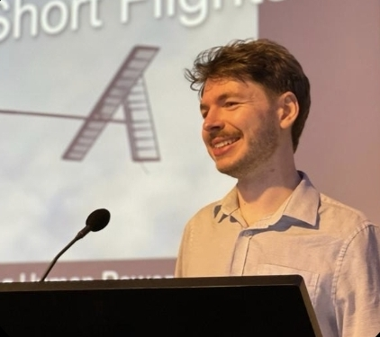

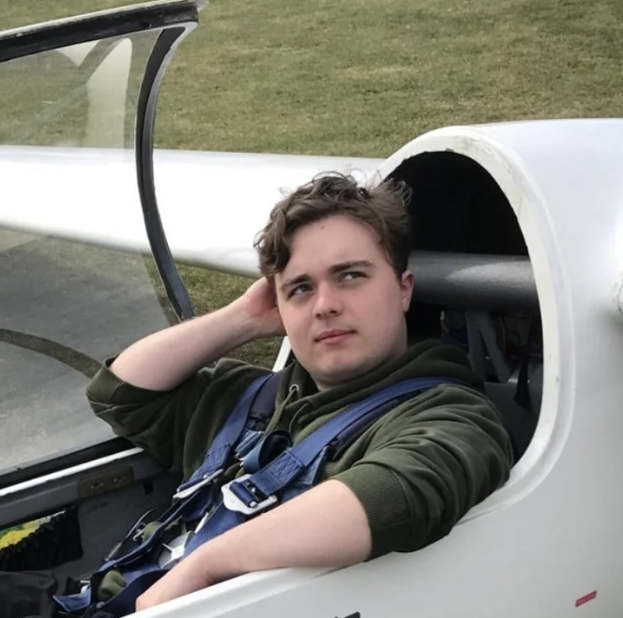
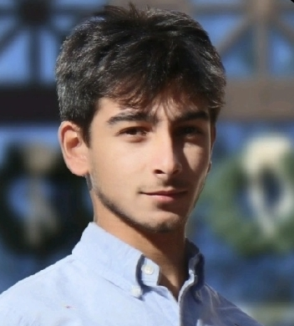

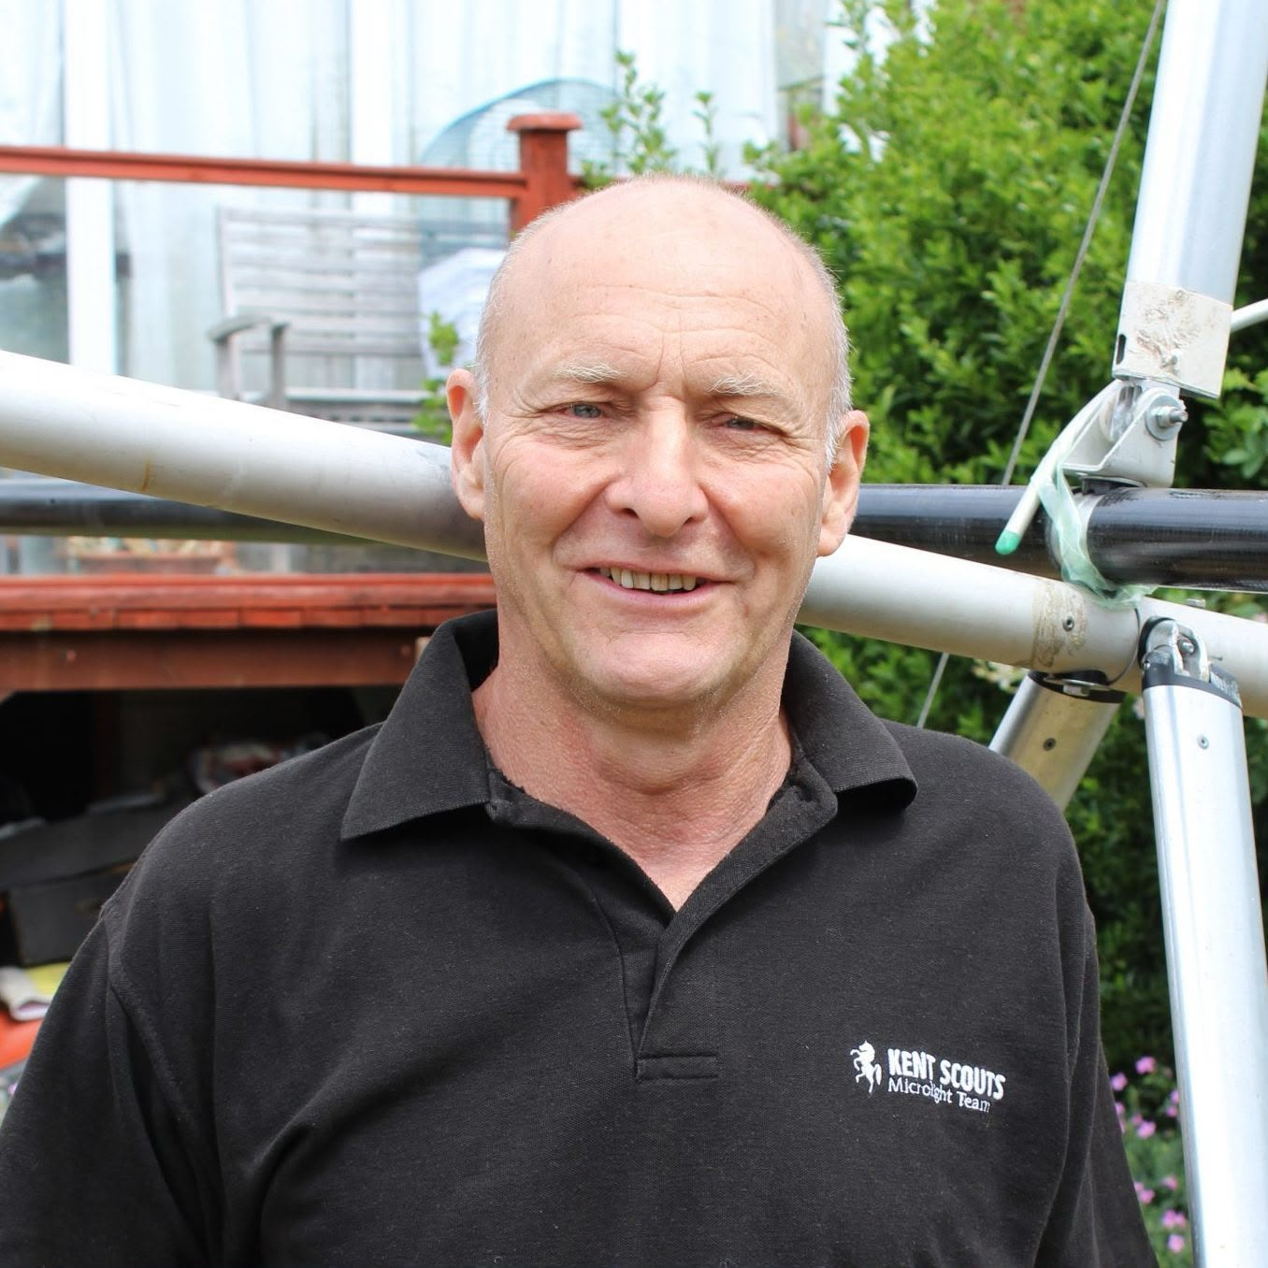
Who’s who
Lewis Rawlinson- President
Kit Buchannan - Treasurer
Alex McDougall-Page - Secretary
William Sander – Safety Off
Muhammad Sarguroh - Media
Yaseen Reza – Media
Tony Prentice – Chief Marshal

Slide 5
Traffic Light System

Slide 6
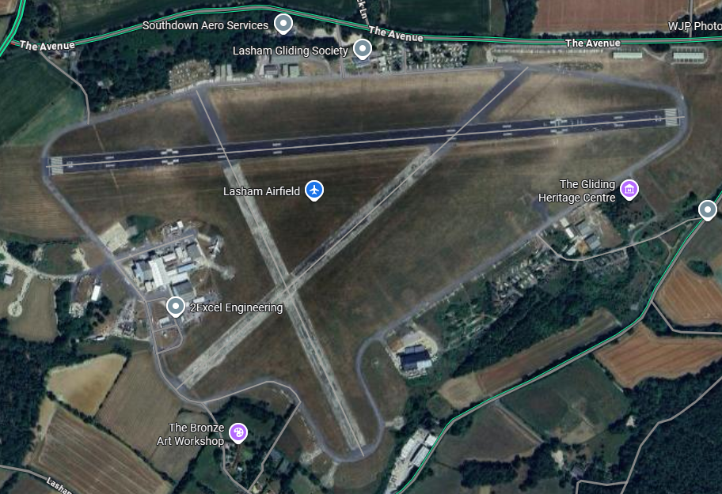
Members Hanger
Lasham Clubhouse
Red
DO NOT enter
Look
out
Area
Amber
PASSING ONLY, LOOKOUT for landing and taking off aircraft
Yellow
CONSTANT AWARNESS
Lookout Area
Lookout Area
Green
Relaxed
Camping Site
Unless flying Human Powered aircraft under BHPFC supervision, or flying with Lasham and UNDER THEIR DIRECT SUPERVISION, or are a licenced pilot

Slide 7
Airfield Hazard Awareness

Slide 8
Landing Small Aircraft
“BE PREPARED TO RUN IF AN AIRCRAFT IS ABOUT TO LAND”
Lasham Ops Manual

Slide 9
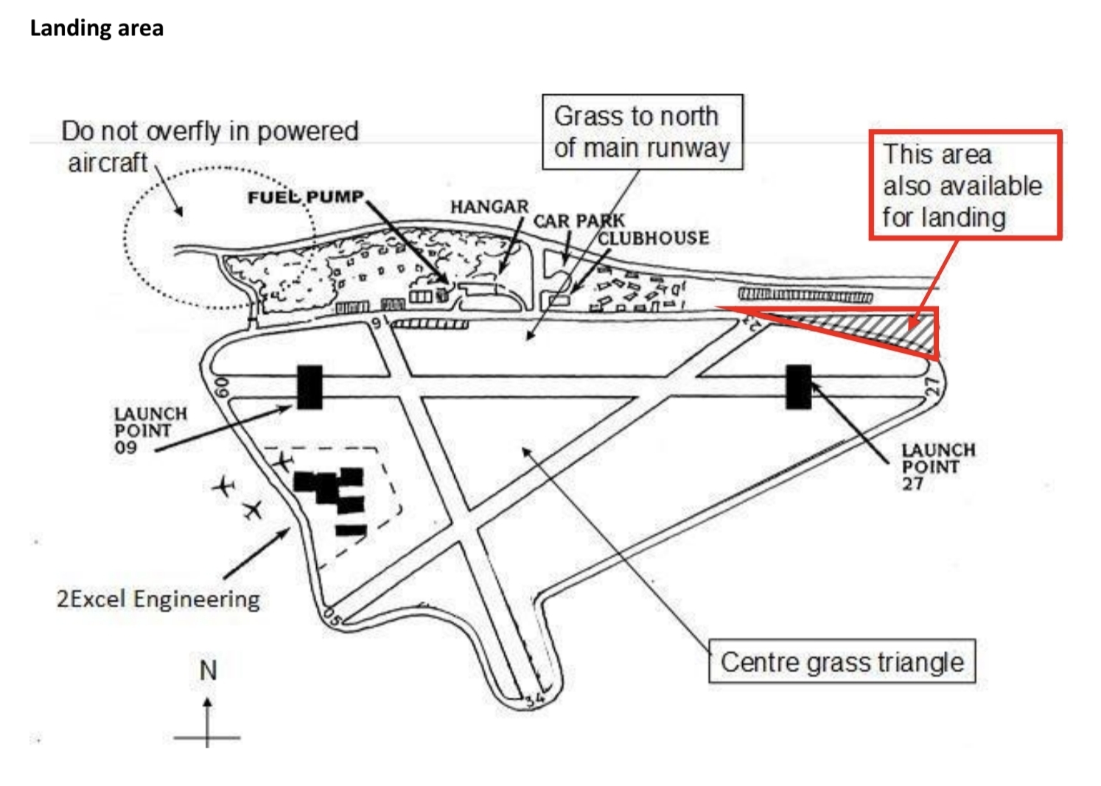
Landing Small Aircraft
“In addition to the three concrete runways, aircraft may land anywhere on the grass within the perimeter track”
“In addition, the highlighted area outside the perimeter track at the eastern end of the airfield is also used for landing”
Lasham Ops Manual
Gliders make no sound when on approach!

Slide 10
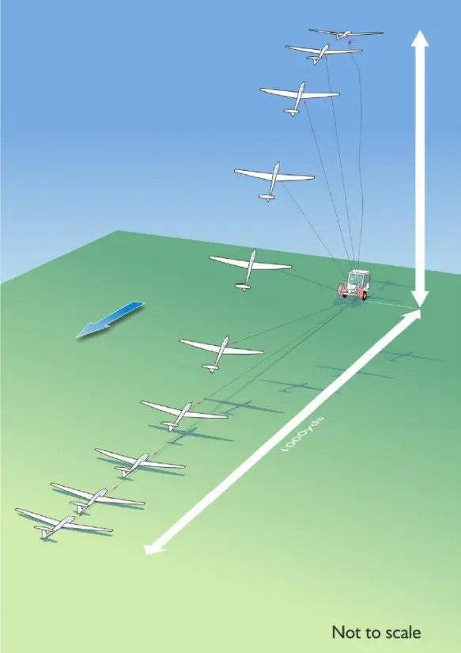
Winch Cables
These span the length of the field and are hard to see
You will not hear the winch reeling in the cable given the distances involved
If it can send a half a ton glider into the air, it will take you up too

Slide 11
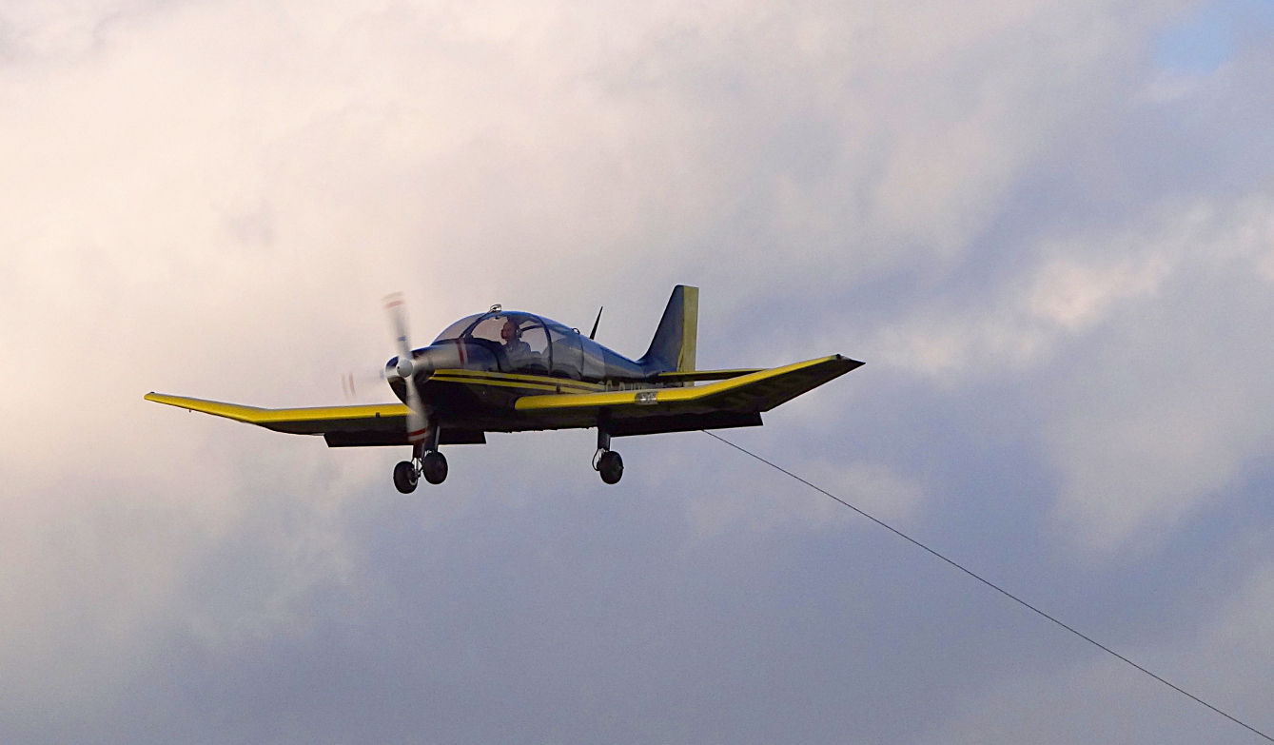
Tug Ropes
“tug aircraft trail ropes”
“that have metal rings at the end”
“It is” “dangerous” “to be in the path of these aircraft”
“The greatest risk is on the perimeter track at the east and west end of the airfield”
Lasham Ops Manual

Slide 12

Propellors
“DO NOT approach a tug aircraft from in front of the wing”
“DO NOT touch the propeller of an aircraft”
“A slight movement on the propeller could cause the engine to start, even if the engine is switched off”
Lasham Ops Manual

Slide 13
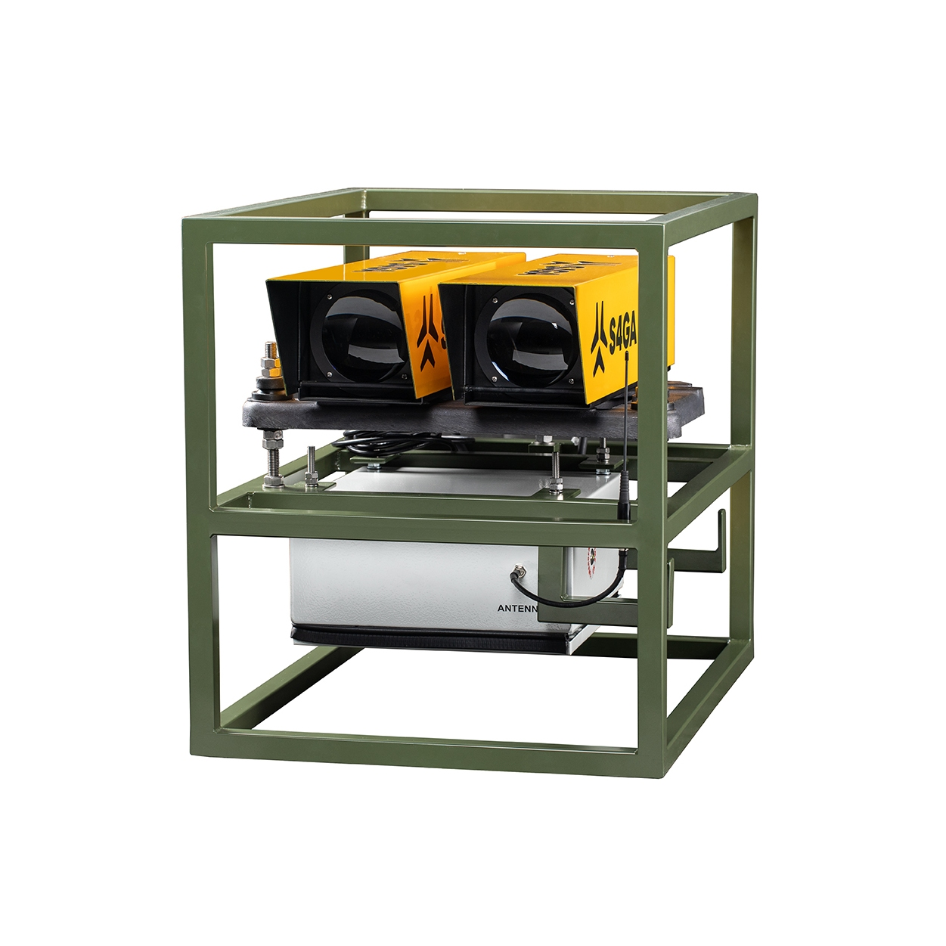
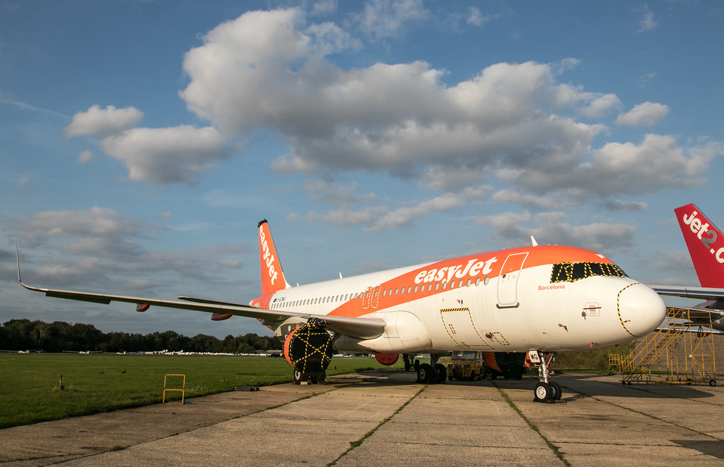
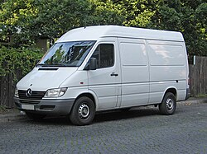
Large Aircraft Movements
Only the main runway is used by large jet aircraft
For arrivals, PAPI lights will be placed north of the runway inbound of the threshold, a white van will also be present to supply power to the lights
A departure is obvious from the appearance of a large jet at the end of the runway

Slide 14
Large Aircraft Movements
Check for a strobe light at the 2Excell Facility
When there are signs of movement STAY CLEAR of the;
  Aircraft
  main runway
  taxiway between 2Excell and the runway
Notes:
Bad english

Slide 15
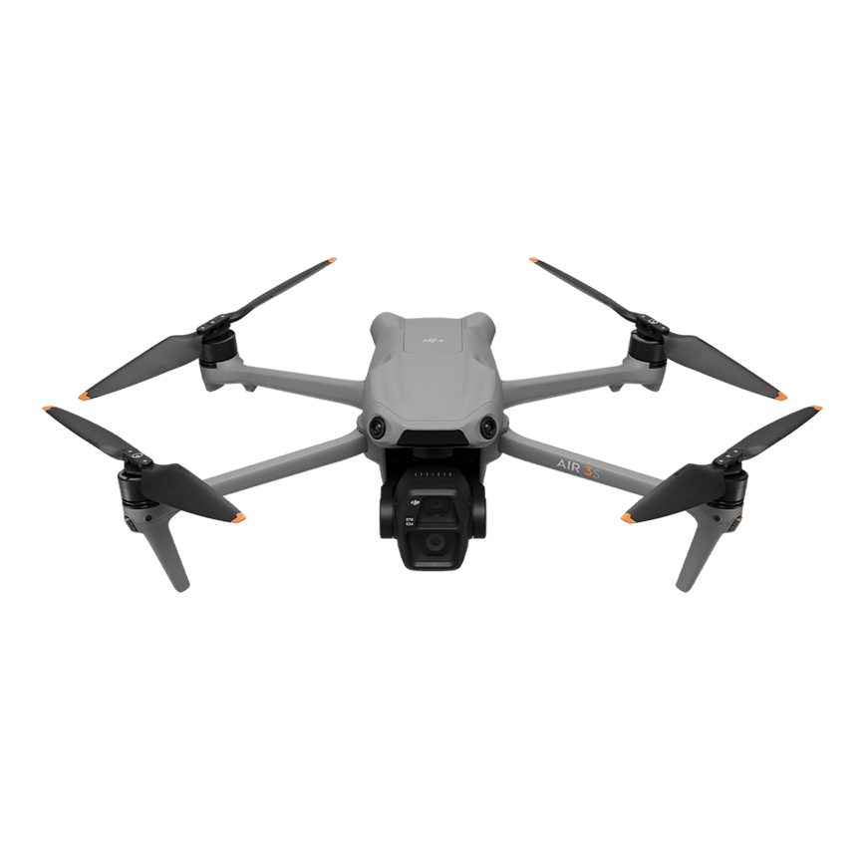
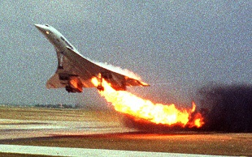
Hazards you could pose
Foreign Object Debris (FOD)
DO NOT leave any items lose on the airfield
Flying Objects
DO NOT fly anything on the airfield that is not a HPA under our supervision on the airfield*
*For drones permission must be sought from Lasham itself, in writing, any conditions given MUST be followed strictly
Notes:
Bad english

Slide 16
General Rules

Slide 17
Driving
DO NOT exceed 20mph
GIVE WAY to all aircraft
EXERCISE EXTREME CAUTION when driving past the clubhouse and caravan areas as children play in these areas
DO NOT drive on the grass area (excluding the campsite)
ACT AS IF you are on the public roads
Notes:
Insurance warning

Slide 18

Alcohol
“IT IS ILLEGAL TO FLY” “WITH BLOOD ALCOHOL” “EXCEEDING 20mg/100ml” “Less than one quarter of the drink-drive limit”(England) “One drink will take you over this limit”
“The Railways and Transport Safety Act applies to anyone involved in flying operations, even a wing-tip holder. If any alcohol is consumed, do not fly or even go to the launch point that day”
Lasham Ops Manual

Slide 19
Incident reporting

Slide 20

Incident/Near Miss Reporting
REPORT EVERYTHING that had or nearly had happened, that did or could have;
  Caused damage to any property
  Caused injury to any person

Slide 21
Climatic Injuries

Slide 22
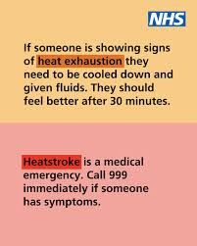
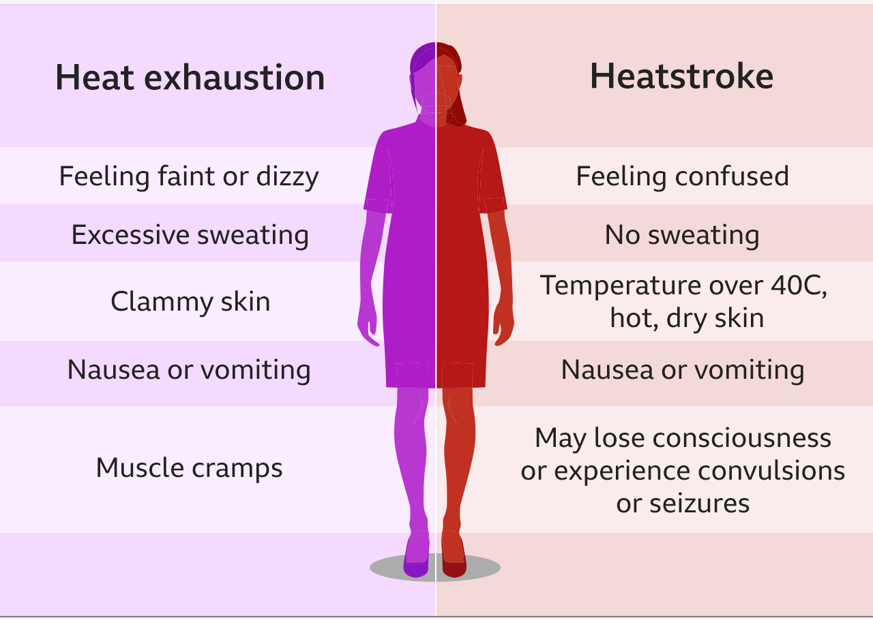
Climatic Injuries
HYDRATE!
If someone shows signs of heat exhaustion/stroke, IMMEDIATLEY;
STOP the local ACTIVITY
GET HELP (depends on severity)
GET THE CASUALTY TO SHADE or BRING THE SHADE TO THEM
REMOVE EXCESS CLOTHING
GIVE WATER TO DRINK AND APPLY TO THE SKIN TO COOL DOWN

Slide 23
Check of understanding
Is there a speed limit airside?
What warning does a glider give when it is about to land?
Can you fly anything in the airfield?
What hangs below the tow planes?
Is heat stroke an emergency?
What should you be ready to do when an aircraft is about to land?
What are the signs there’s about to be a jet movement?
Where can you not go without permission?
What needs reporting?
Can you drink and fly?

Slide 24
Summary
KEEP YOUR HEAD ON A SWIVEL, this is an active airfield
FOLLOW the traffic light rules
REPORT any and everything
Just because we’re on “private property” DOES NOT mean you can drive your car any differently than you would on the road

